Slide 1

Advanced Gamma-Ray Science
Methods and Tools
K.Kosack, J.Decock
CEA Saclay – Irfu/Sap
November 29, 2016
Notes:
15mn de présentation + 5mn pour les questions.
The goal of this project is to study modern techniques of si- gnal processing from the wider scientific and mathematical community and apply them to the analysis of very-high-en- ergy gamma ray data. This applies both to the reconstruction of raw data from Cherenkov telescopes, where we strive to lower the energy threshold and improve angular resolution and cosmic-ray rejection, to the realtime detection of tran- sient sources in high-level data. This study will benefit current and future gamma ray instruments, in particular the upcoming Cherenkov Telescope Array (CTA) observatory while simultaneously giving visibility to local groups within several large projects.
Hello everyone
I'm Jeremie Decock
I'm Postdoc at CEA Saclay
I work in the astrophysics division under the supervision of Karl Kosack
And I will briefly introduce our work on advance image cleaning
Work made in collaboration with the Cosmostat group in CEA Saclay

Slide 2


PRoject Context:
group development
Goal of young-team project:
(Europe)
Develop a group to work on gamma-ray techniques locally at CEA
Improve overlap with related groups
Involve new people in gamma-ray analysis
HESS group
(SAp + SPP)
SAp CTA Group
UnivEarths
Advanced Gamma Project
CosmoStat Group (SAp)
APC Group
(Paris Diderot)

Slide 3
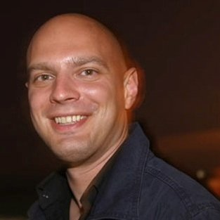
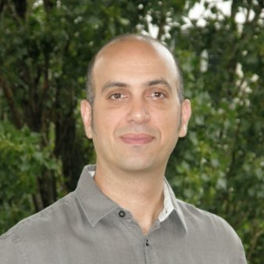
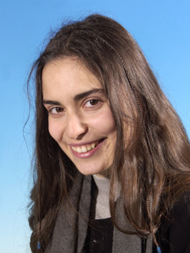
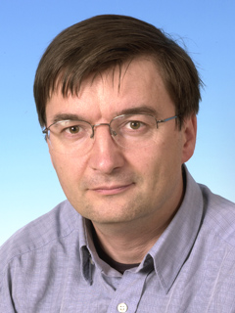
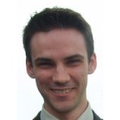
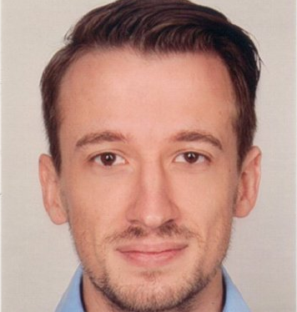
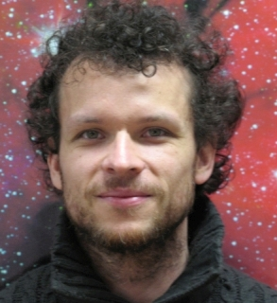
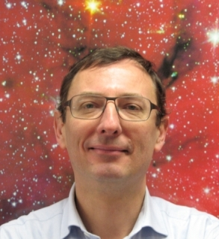
PROJECT MANAGEMENT:
The Team
WP Leader
Jérémie Decock
Karl Kosack
Bruno Khélifi
Sandrine Pires
David Landriu
+
CEA/AIM
CNRS/APC
CEA/AIM
CEA/AIM
UnivEarths post-doc
Doctor of Computer Science, Inria
Numerical techniques and software development
Mathematical optimization
Signal processing
CosmoStat
Euclid, Kepler
HESS, CTA
HESS, CTA
Fermi,
CTA
Tino Michael
Fabio Acéro
Thierry Stolarczyk
CEA/AIM
CNRS/AIM
CEA/AIM
CTA, ASTERICS
CTA, Fermi
CTA (leader)
Notes:
What am I supposed to say ?
Bruno Khélifi ?
Fabian Schüssler ?

Slide 4
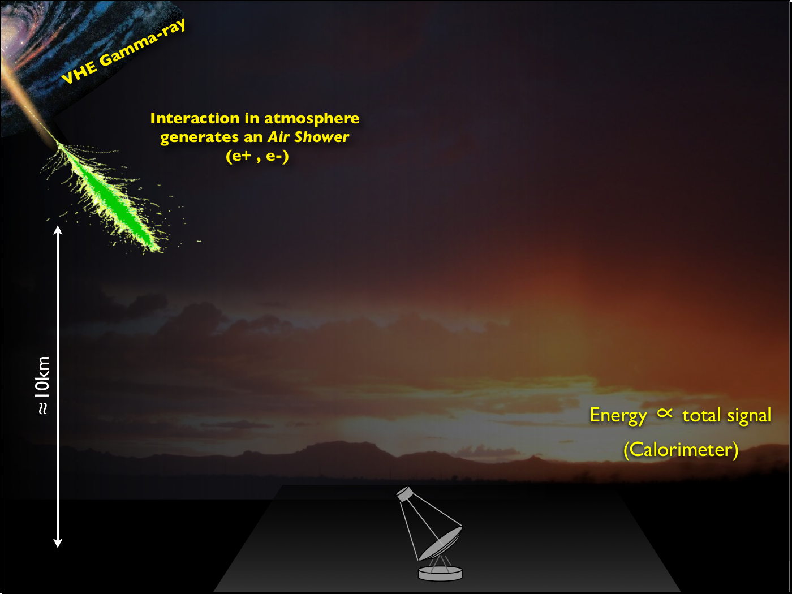
How Cherenkov Telescopes Work

Slide 5
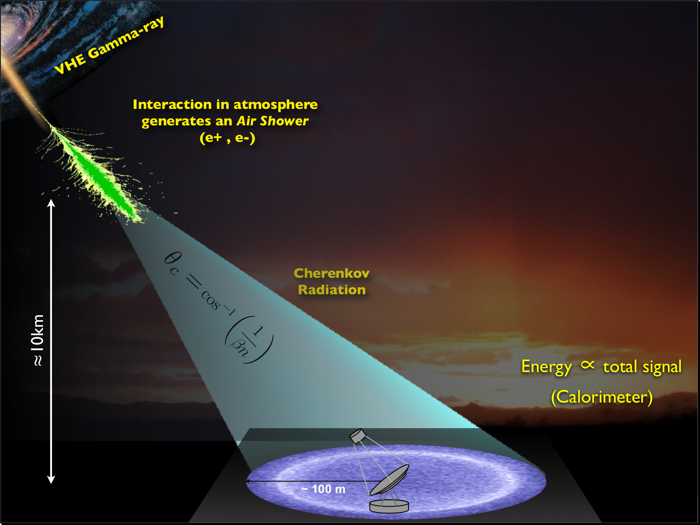
Gamma-rays produce air showers
glow in Cherenkov light
detected by very sensitive optical telescopes

Slide 6
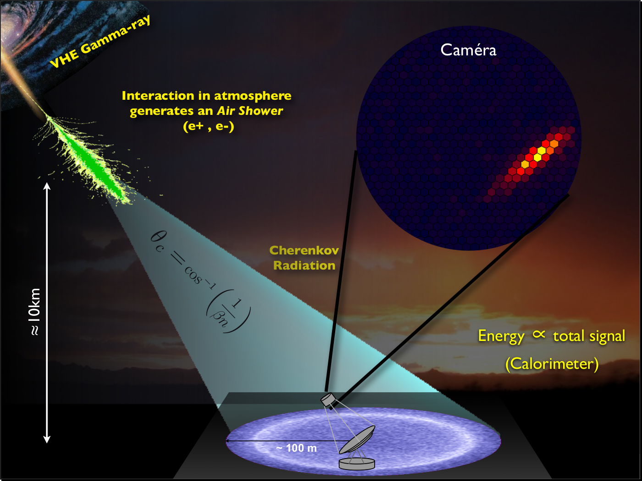
Cameras image showers at ns timescales
very low S/N

Slide 7
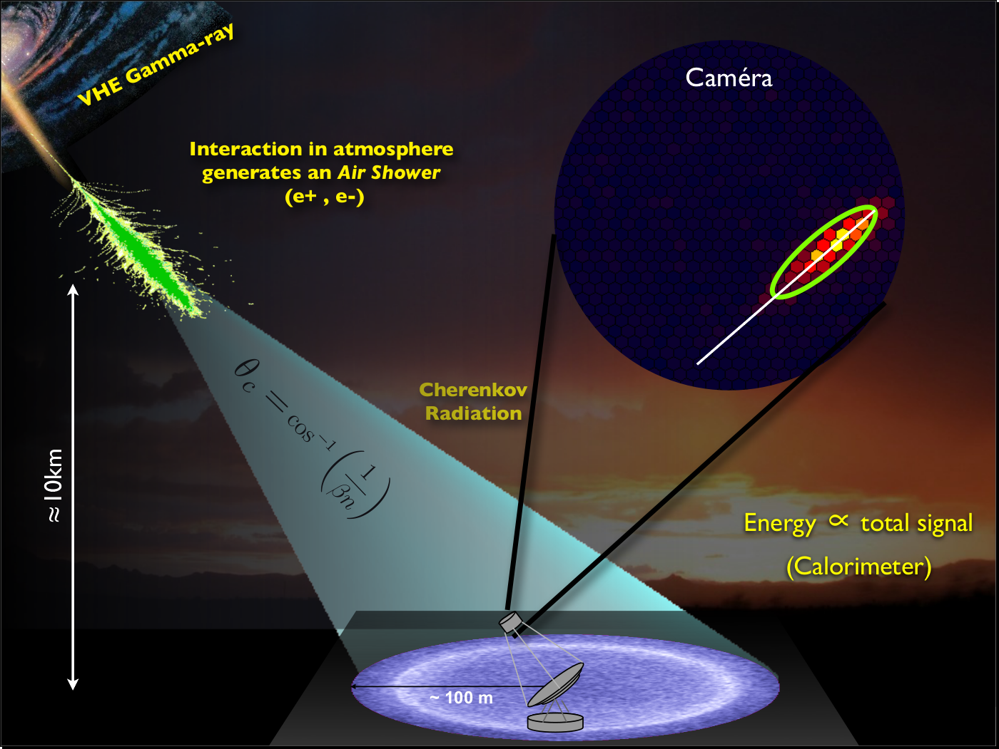
Shower Images (which may have time axis)
must be de-noised and parameterized
for reconstruction

Slide 8
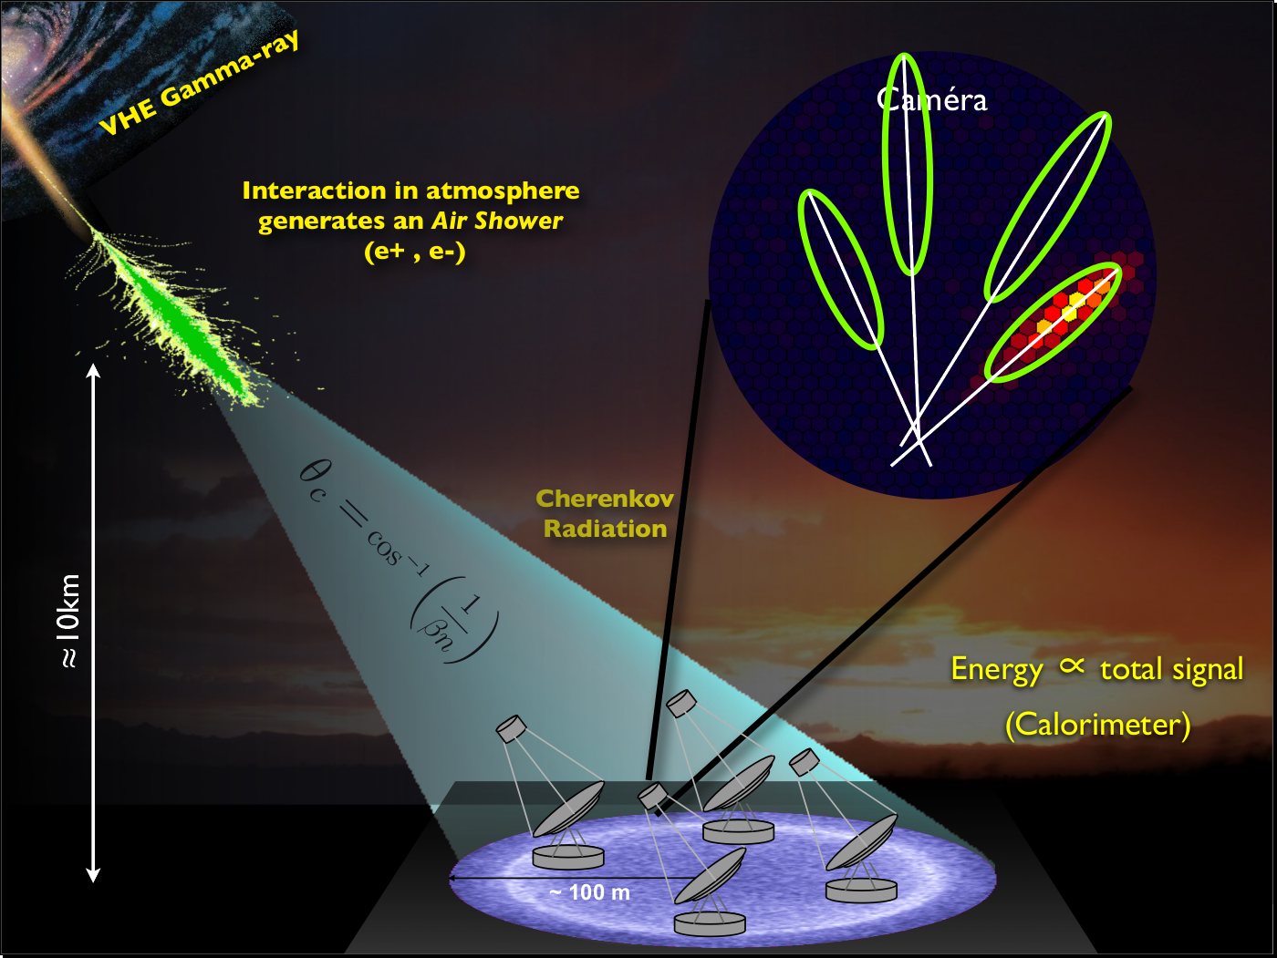
And then combined in Stereo

Slide 9
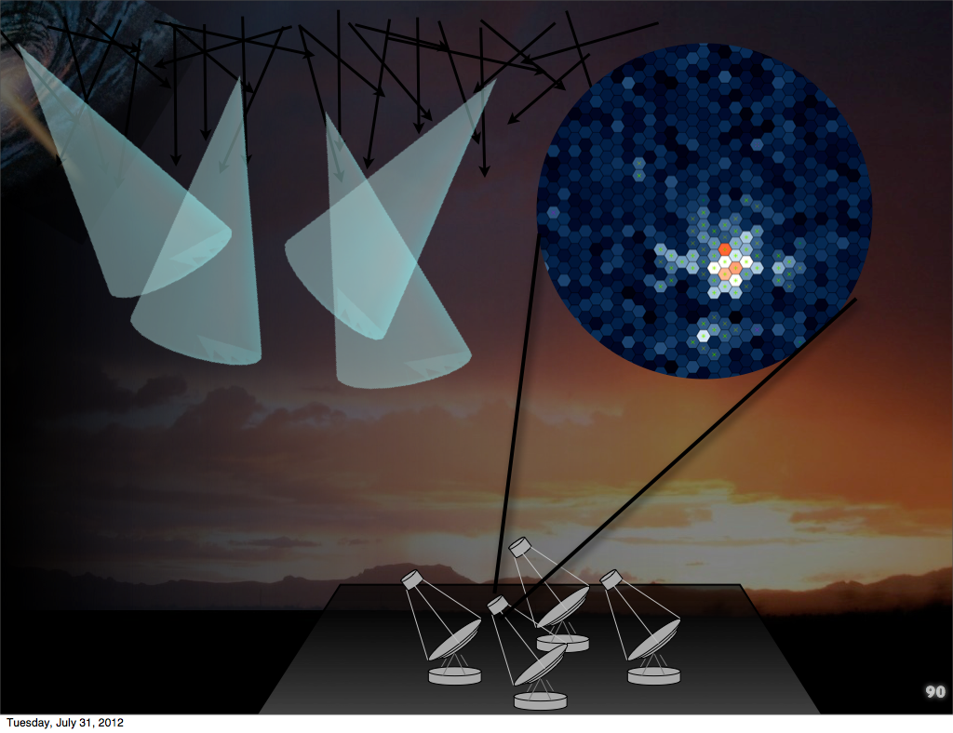
Cosmic Ray Background
dominates the gamma-rays by 5 orders of magnitude
Their images have a rougher morphology, which is difficult to distinguish due to low S/N
note this is an ideal case (reality is usually worse)

Slide 10
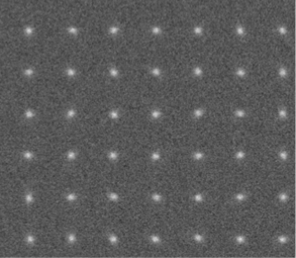
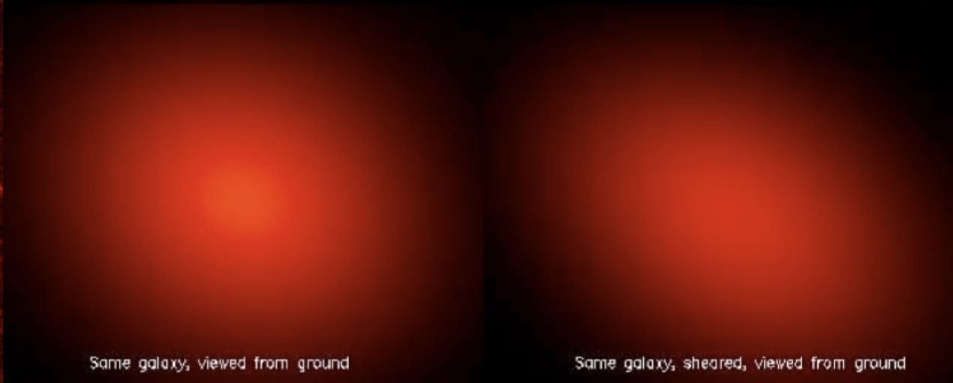
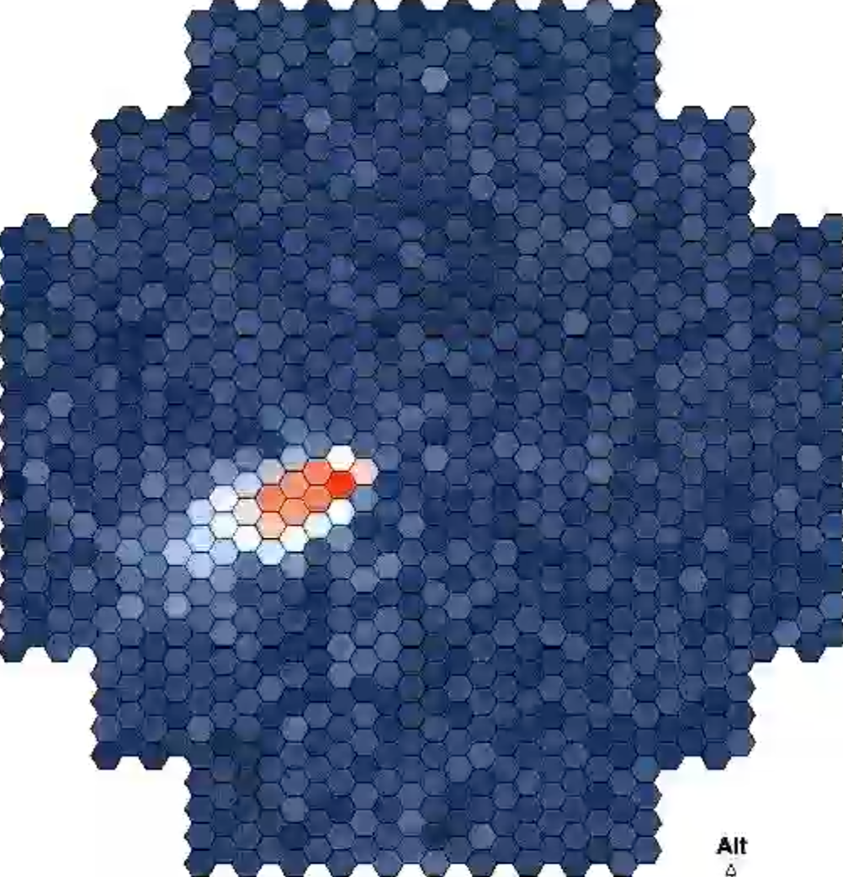
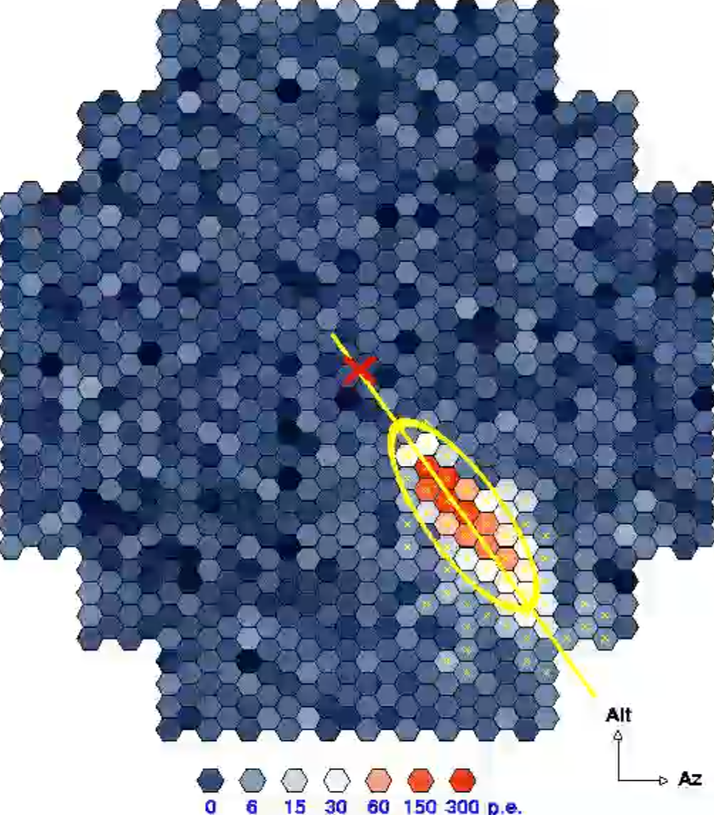
THE IDEA:
Synergies with Other Fields
An example: Weak Gravitational Lensing
Look for and parameterize minute shears in images of galaxies
Galaxy images are low Gaussian signals on high-noise background
This is nearly identical to the problem we have when reconstructing Cherenkov-light images of showers
Very different physics, same mathematics…
The techniques developed for Weak lensing are far more advanced than what are currently used for gamma rays and can be exploited
Weak Lensing
denoise + calculate moments, skewness, kurtosis for millions of [galaxy|shower] images on poisson background and reconstruct underlying distribution
Gamma-ray reconstruction
e.g "Weak Lensig Mass Reconstrcution using Wavelets", J.-L. Starck, S. Pires, and A. Refregier, A&A, 451, 3, 1139-1150, 2006

Slide 11
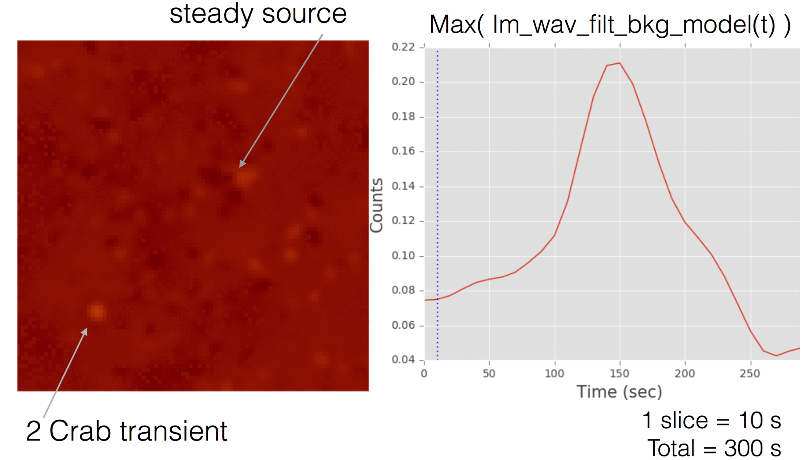
PROJECT:
Focus on two aspects for Cherenkov Telescopes
Gamma-ray reconstruction and discrimination
Better de-noising and image characterization
Improve PSF and energy threshold
Improve data volume reduction with less loss for CTA (factor of 100x needed)
Realtime transient detection
Wide field-of-view
Changing detector conditions (atmosphere)
Complex detector response
Reduce reliance on calibration and pre-calculated instrumental response functions
Primary project of JD
Project of other team members (came out of interest in techniques studied by JD)
Same techniques applied to reconstructed gamma-ray data

Slide 12
Subject
Try to improve image cleaning before reconstruction (Hillas)
Improve methods to remove:
Instrumental noise
Background noise
Motivations:
Keep more signal (deeper into the noise)
Reduce threshold
Maybe eventually do cleaning and time-integration all at once

Slide 13
The “Tailcut clean” algorithm
A very simple cleaning procedure:
Keep pixels above a given threshold (e.g. 50% max)
Keep some neighbors of these selected pixels: those above a second (lower) threshold (e.g. 25% max)

Slide 14
Remarks
Fast and simple
Sufficient for bright showers
But surely we can do better for faint showers

Slide 15
Basic idea to go beyond
Tailcut method: threshold in the main space
Better idea: threshold in a different space where signal and noise can be easily separated
Wavelet transform
Cosmostat tools (iSAP/Sparse2D)
(http://www.cosmostat.org/software/isap/)

Slide 16
We are considering Wavelet Transform method
Roughly the same idea than doing filtering with Fourier Transform
Apply the transform on the signal
Apply a threshold in the transformed space
Invert the transform to go back to the original signal space
Differences with Fourier Transform
Use functions named wavelets instead sin and cos functions as new bases in the transformed space
The transformed space contains spatial information

Slide 17
Example of wavelet function (Morlet wavelet)
“A short wave-like oscillation with a beginning and an end”

Slide 18
Cleaning procedure: general idea with Fourier Transform
Input signal is converted to a weighted sum of sin and cos at different frequencies
Threshold is applied on these weights to remove some frequencies in the input signal (e.g. high pass filter, low pass filter, ...)

Slide 19
Cleaning procedure: general idea with Wavelet Transform
Input signal is converted to a weighted sum of these wavelet functions at different scales (dilate factor) and positions (translate factor)
Threshold is applied on these weights to remove locally (in space or time) some frequencies (or scales) in the input signal

Slide 20
Find a base where signal and noise can be easily separated
In this example:
Remove noise in direct space is difficult
Remove noise in the transformed space is easy:
noise is uniformly distributed on small coefficients
signal is defined by few big coefficients

Slide 21
Example

Slide 22
Example

Slide 24

Project:
PLan/timeline
 | Q1 2015 | Q2 2015 | Q3 2015 | Q4 2015 | Q1 2016 | Q2 2016 | Q3 2016 | Q4 2016 | Q1 2017 | Q2 2017 | Q3 2017 | Q4 2017 | Q1 2018
Postdoc Search
Postdoc employment |  |  |  | delay
Technique Study
Implementation & test (recon), simplified data
Implementation & test (recon) with realistic data |  |  |  |  |  |  |  | delay
Implementation & test (transients)
Final Validation |  |  |  |  |  |  |  | delay | delay
Technique Publication
Main Deliverables:
Code library adapted for use for Cherenkov Telescopes (open-source, python)
Validation report (plots and results for realistic data, MC for CTA or real for HESS if possible)
Publication on technique / documentation
Schedule notes:
Some unforeseen delays at start of project
Challenges to finish on time:
Adapt techniques to realistic data (see later)
Validation of technique (results look promising, but some questions)
Notes:
TODO:
What am I supposed to say ? (too much information)
Recon -> reconstruction ?
Some questions -> which ones ?

Slide 25
Summary
Modern signal processing techniques appear to be very useful for Cherenkov Telescope data
This Work has piqued the interest of other members, started new projects and fostered inter-group work

Slide 26
Thank you

